Slide 1
Chapter 2: Normalization

Slide 2
Chapter 2: Normalization
Purpose of Normalization
Data Redundancy and Update Anomalies
Functional Dependencies
Identifying Functional Dependencies
Identifying the Primary key using Functional Dependencies
The Process of Normalization
First Normal Form (1NF)
Second Normal Form (2NF)
Third Normal Form (3NF)
Boyce Codd Normal Form (BCNF)
Fourth Normal Form (4NF)
Fifth Normal Form (5NF)

Slide 3
Relational Database Design
The goal of a relational-database design is to generate a set of relation schemas that allows us to store information without unnecessary redundancy, yet also allows us to retrieve information easily.
One approach is to design schemas that are in an appropriate normal form, known as normalization.
Begins by examining the relationships called FDs between attributes
Uses series of tests ( Normal forms) to help identify grouping of attributes

Slide 4
Purpose of Normalization
The purpose of normalization is to identify a suitable set of relations that support the data requirements of an enterprise.
The characteristics of a suitable set of relations include the following:
  the minimal number of attributes necessary to support the data requirements of the enterprise;
  minimal redundancy with each attribute.
  attributes with a close logical relationship (described as functional dependency) are found in the same relation;
Can be used at any stage of DB design

Slide 5
Purpose of Normalization
A large database defined as a single relation may result in data duplication. This repetition of data may result in:
  Making relations very large.
  It isn't easy to maintain and update data as it would involve searching many records in relation.
  Wastage and poor utilization of disk space and resources.
  The likelihood of errors and inconsistencies increases.
So to handle these problems, we should analyze and decompose the relations with redundant data into smaller, simpler, and well-structured relations that are satisfy desirable properties.
Normalization is a process of decomposing the relations into relations with fewer attributes.

Slide 6
What is Normalization
Normalization is the process of organizing the data in the database.
is used to minimize the redundancy from a relation or set of relations.
It is also used to eliminate undesirable characteristics like Insertion, Update, and Deletion Anomalies.
divides the larger table into smaller and links them using relationships.
The normal form is used to reduce redundancy from the database table.

Slide 7
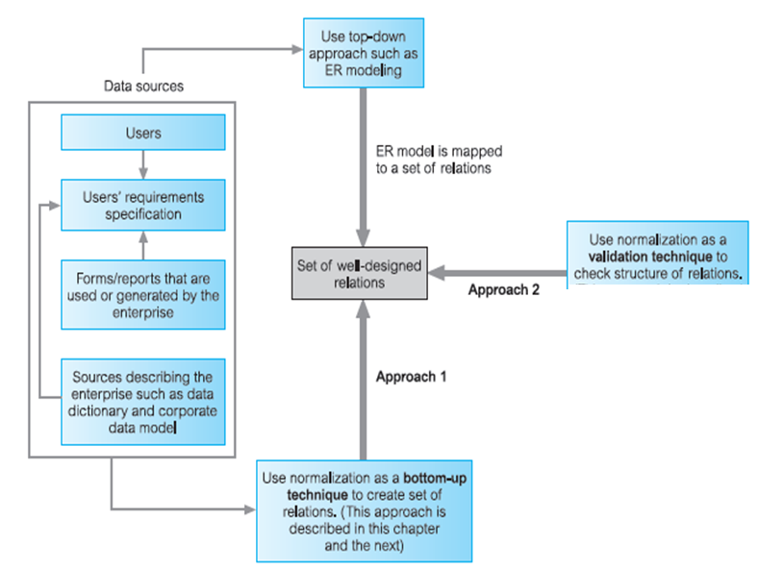
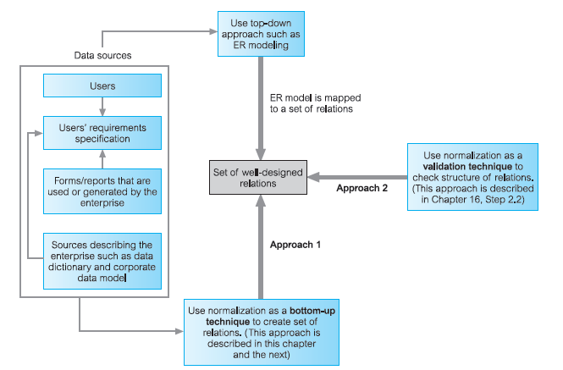
How Normalization Supports Database Design

Slide 8
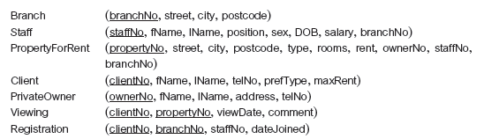
Property Database

Slide 9
Data Redundancy and Update Anomalies
A major aim of relational database design is to group attributes into relations to minimize data redundancy.
If this goal is achieved, then
  updates to the data stored in the database are achieved with a minimal number of operations thus reducing the opportunities for data inconsistencies occurring in the database;
  reduction in the file storage space required by the base relations thus minimizing costs.
Relations that have redundant data may have problems called update anomalies

Slide 10
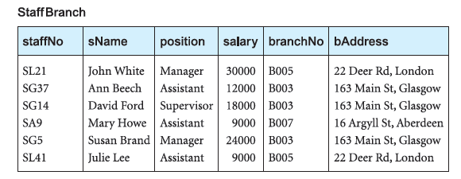
Data Redundancy and Update Anomalies
StaffBranch (staffNo, sName, position, salary, branchNo, bAddress)

Slide 11
Data Redundancy and Update Anomalies
The relations have the form:
StaffBranch (staffNo, sName, position, salary, branchNo, bAddress)
Redundant data in StaffBranch
Relations that have redundant data may have problems called update anomalies, which are classified as
  insertion,
  deletion, or
  modification anomalies.

Slide 12
update anomalies
Data modification anomalies can be categorized into three types:
Insertion Anomaly: Insertion Anomaly refers to when one cannot insert a new tuple into a relationship due to lack of data.
Deletion Anomaly: The delete anomaly refers to the situation where the deletion of data results in the unintended loss of some other important data.
Updatation Anomaly: The update anomaly is when an update of a single data value requires multiple rows of data to be updated.

Slide 13
Insertion Anomalies
There are two main types of insertion anomaly. Consider StaffBranch relation:
To insert the details of new members of staff into the StaffBranch relation, we must include the details of the branch at which the staff are to be located.
To insert details of a new branch that currently has no members of staff into the StaffBranch relation, it is necessary to enter nulls into the attributes for staff, such as staffNo.
However, as staffNo is the primary key for the StaffBranch relation, attempting to enter nulls for staffNo violates entity integrity, and is not allowed. We therefore cannot enter a tuple for a new branch into the StaffBranch relation with a null for the staffNo.

Slide 14
Deletion Anomalies
If we delete a tuple from the StaffBranch relation that represents the last member of staff located at a branch, the details about that branch are also lost from the database.

Slide 15
Modification Anomalies
If we want to change the value of one of the attributes of a particular branch in the StaffBranch relation, for example the address for branch number B003, we must update the tuples of all staff located at that branch.
If this modification is not carried out on all the appropriate tuples of the StaffBranch relation, the database will become inconsistent.

Slide 16
Decomposition
The StaffBranch relation is subject to update anomalies, we can avoid these anomalies by decomposing the original relation into the Staff and Branch relations.
The Staff and Branch relations have more desirable properties than the StaffBranch relation.
There are two important properties associated with decomposition of a larger relation into smaller relations:
The lossless-join property ensures that any instance of the original relation can be identified from corresponding instances in the smaller relations.
The dependency preservation property ensures that a constraint on the original relation can be maintained by simply enforcing some constraint on each of the smaller relations.

Slide 17

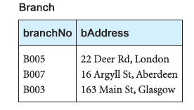
Data Redundancy and Update Anomalies
Staff (staffNo, sName, position, salary, branchNo)
Branch (branchNo, bAddress)

Slide 18
Functional Dependencies
An important concept associated with normalization is functional dependency, which describes the relationship between attributes.
Functional dependencies play a key role in differentiating good database design from bad database design.
It’s a constraints on the set of legal relations.
Functional dependencies requires that the value for a certain set of attributes uniquely determines the value for another set of attributes.
A functional dependency is a generalization of the notion of a key.

Slide 19
Functional Dependencies (Cont.)
Let R be a relation schema
α ⊆ R and β ⊆ R
The functional dependency
α → β
holds on R if and only if, for any legal relations r(R), whenever any two tuples t₁ and t₂ of r agree on the attributes α, they also agree on the attributes β. That is,
t₁[α] = t₂ [α] ⇒ t₁[β ] = t₂ [β ]
or α uniquely indentify β
Example: Consider r(A,B) with the following instance of r.
On this instance, A → B does NOT hold, but B → A does hold.
4
1 5
3 7

Slide 20
Functional Dependencies (Cont.)
A B
1 4
1 4
2 4 3 7
A C
a₁ c₁ a₁ c₁
a₂ c₂
a₂ c₂ a₃ c₂
On this instance, A → B does
hold, but B → A does NOT hold
On this instance, A → C does hold, but C → A does NOT hold

Slide 21
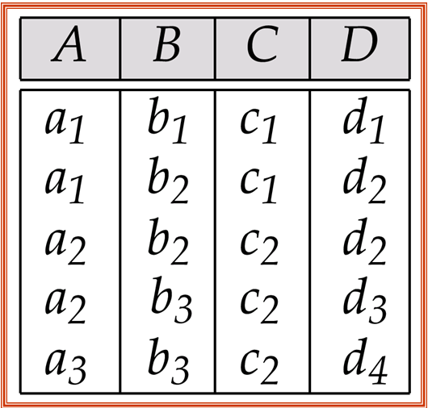
Sample Relation r
Satisfied: Not Satisfied:
A → C C → A
D → Β Β → D
AB → D A → D

Slide 22

Functional Dependencies (Cont.)
Determinant: When a functional dependency exists, the attribute or group of attributes on the left hand side of the arrow is called the determinant.
For example, following figure A is the determinant of B.

Slide 23
Example of a functional dependency

Slide 24
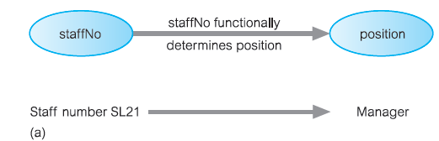
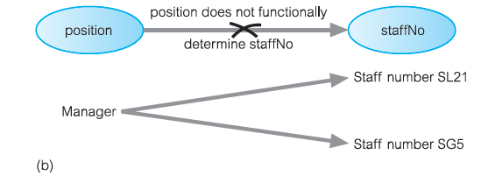
Example of a functional dependency
Consider the attributes staffNo and position of the Staff relation.
(a) staffNo functionally determines position
  (staffNo → position)
(b) position does not functionally determine staffNo
(position → staffNo).

Slide 25
Example of a functional dependency
In this example, staffNo is the determinant of this functional dependency.
For the purposes of normalization we are interested in identifying functional dependencies between attributes of a relation that have a one-to-one relationship between the attribute(s) that makes up the determinant on the left-hand side and the attribute(s) on the right-hand side of a dependency.

Slide 26
Example of a functional dependency that holds for all time
Consider the values staffNo and sName attributes of the Staff relation.
Initially, the staffNo attribute functionally determines the sName attribute and/or that the sName attribute functionally determines the staffNo attribute :
    staffNo →sName
    sName →staffNo
But it is possible for the sName attribute to hold duplicate values for members of staff with the same name, then for some members of staff in this category we would not be able to determine their staff number (staffNo).
we want to identify functional dependencies that hold for all possible values for attributes of a relation as these represent the types of integrity constraints that we need to identify

Slide 27
Example of a functional dependency
The relationship between staffNo and sName is one-to-one (1:1): for each staff number there is only one name.
On the other hand, the relationship between sName and staffNo is one-to-many (1:*): there can be several staff numbers associated with a given name.
The functional dependency that remains true after consideration of all possible values for the staffNo and sName attributes of the Staff relation is:
    staffNo →sName

Slide 28
Full Functional Dependency
An additional characteristic of functional dependencies that is useful for normalization is that their determinants should have the minimal number of attributes necessary to maintain the functional dependency with the attribute(s) on the right hand-side. This requirement is called full functional dependency.
A functional dependency A → B is a full functional dependency if removal of any attribute from A results in the dependency no longer existing.
Indicates that if A and B are attributes of a relation, B is fully functionally dependent on A if B is functionally dependent on A, but not on any proper subset of A.
A functional dependency A → B is a partially dependency if there is some attributes (extraneous attributes) that can be removed from A and yet the dependency still holds.

Slide 29
Example:
  staffNo, sName →branchNo : partial dependency
  staffNo →branchNo : full functional dependency
It is correct to say that each value of (staffNo, sName) is associated with a single value of branchNo.
However, it is not a full functional dependency because branchNo is also functionally dependent on a subset of (staffNo, sName), namely staffNo.
In other words, the functional dependency shown above is an example of a partial dependency.

Slide 30
Characteristics of functional dependencies
The functional dependencies that we use in normalization have the following characteristics:
There is a one-to-one relationship between the attribute(s) on the left-hand side (determinant) and those on the right-hand side of a functional dependency.
They hold for all time.
The determinant has the minimal number of attributes necessary to maintain the dependency with the attribute(s) on the right-hand side. In other words, there must be a full functional dependency between the attribute(s) on the left- and right-hand sides of the dependency.

Slide 31
Transitive Functional Dependency
A condition where A, B, and C are attributes of a relation such that if A → B and B → C, then C is transitively dependent on A via B (A → C).
Example:
  staffNo →sName, position, salary, branchNo, bAddress
  branchNo →bAddress
  staffNo → bAddress
  The staffNo attribute functionally determines the bAddress via the
  branchNo attribute.

Slide 32
Trivial and Nontrivial Functional dependency
Functional dependency A->B is a trivial dependency if B is a subset of A
  Eg: staffNo sName → sName
Functional dependency A->B is a nontrivial dependency if B is not a subset of A
  Eg: staffNo → sName

Slide 33
Identifying Functional Dependencies
Identifying all functional dependencies between a set of attributes should be quite simple if the meaning of each attribute and the relationships between the attributes are well understood.

Slide 34
Identifying Functional Dependencies
Example: Consider attributes in StaffBranch relation.
The functional dependencies based on our understanding of the attributes in the relation as:
    staffNo →sName, position, salary, branchNo, bAddress
    branchNo →bAddress
    bAddress →branchNo
    branchNo, position →salary
    bAddress, position →salary
With staffNo, branchNo, bAddress, (branchNo, position), and (bAddress, position) as determinants.

Slide 35
Identifying Functional Dependencies
However, if the users are unavailable for consultation and/or the documentation is incomplete, then, depending on the database application, it may be necessary for the database designer to use their common sense and/or experience to provide the missing information.
Example: Consider the data for attributes denoted A, B, C, D, and E in the Sample relation of Figure next.

Slide 36
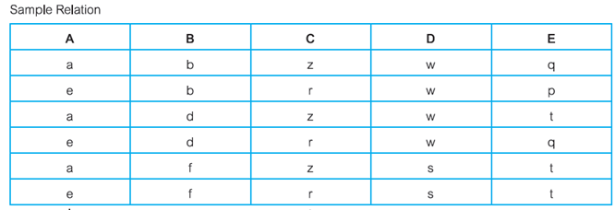
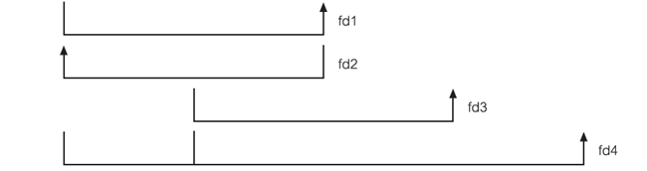
Identifying Functional Dependencies
A → C (fd1)
C → A (fd2)
B → D (fd3)
A, B → E (fd4)

Slide 37
Identifying the primary key for the StaffBranch relation
To identify the candidate key(s) for the StaffBranch relation, we must identify the attribute (or group of attributes) that uniquely identifies each tuple in this relation.
If a relation has more than one candidate key, we identify the candidate key that is to act as the primary key for the relation (see Section 3.2.5).
All attributes that are not part of the primary key (non-primary-key attributes) should be functionally dependent on the key.
The only candidate key of the StaffBranch relation, and therefore the primary key, isstaffNo, as all other attributes of the relation are functionally dependent on staffNo.

Slide 38
Identifying the primary key for the Sample relation
The determinants in the Sample relation are A, B, C, and (A, B).
A → C (fd1), C → A (fd2),
B → D (fd3), A, B → E (fd4)
However, the only determinant that functionally determines all the other attributes of the relation is (A, B). In particular, A functionally determines C, B functionally determines D, and (A, B) functionally determines E.
In other words, the attributes that make up the determinant (A, B) can determine all the other attributes in the relation either separately as A or B or together as (A, B).
As there are no other candidate keys for the Sample relation (A, B) is identified as the primary key for this relation.

Slide 39
Inference Rules for Functional Dependencies
From given set of functional dependencies we can derive another set of functional dependencies.
The set of all functional dependencies that are implied by a given set of functional dependencies X is called the closure of X, written X^{+.}
A set of inference rules, called Armstrong’s axioms are used to compute X⁺ from X.
Let A, B, and C be subsets of the attributes of the relation R. Armstrong’s axioms are as follows:
(1) Reﬂexivity: If B is a subset of A, then A → B (trivial FD)
(2) Augmentation: If A → B, then A,C → B,C
(3) Transitivity: If A → B and B → C, then A → C
These rules are
  sound (do not generate any incorrect functional dependencies) and
  complete (generate all functional dependencies that hold).

Slide 40
Inference Rules for Functional Dependencies
Several further rules can be derived from the three given above that simplify the practical task of computing X⁺.
In the following rules, let D be another subset of the attributes of relation R, then:
(4) Self-determination: A → A (trivial FD)
(5) Decomposition: If A → B,C, then A → B and A → C
(6) Union: If A → B and A → C, then A → B,C
(7) Composition: If A → B and C → D then A,C → B,D

Slide 41
Example
R = (A, B, C, G, H, I)
F = { A → B
A → C
CG → H
CG → I
B → H}
some members of F⁺
  A → H
    by transitivity from A → B and B → H
  CG → HI
    from CG → H and CG → I : “union rule” can be inferred from
      definition of functional dependencies, or
  Similarly, A → BC by union rule.

Slide 42
Closure of attribute set
The set of all those attributes which can be functionally determined from an attribute set is called as a closure of that attribute set.
Closure of attribute set {A} is denoted as {A}⁺.
1: Add the attributes contained in the attribute set for which closure is being calculated to the result set.
2: Recursively add the attributes to the result set which can be functionally determined from the attributes already contained in the result set.

Slide 43
Closure of attribute set
Consider a relation R ( A , B , C , D , E , F , G ) with the functional dependencies-
  A → BC
  BC → DE
  D → F
  CF → G
A⁺ = { A }
= { A , B , C } ( Using A → BC )
= { A , B , C , D , E } ( Using BC → DE )
= { A , B , C , D , E , F } ( Using D → F )
= { A , B , C , D , E , F , G } ( Using CF → G )
Thus,
A⁺ = { A , B , C , D , E , F , G }

Slide 44
Closure of attribute set
{ B , C }⁺= { B , C }
= { B , C , D , E } ( Using BC → DE )
= { B , C , D , E , F } ( Using D → F )
= { B , C , D , E , F , G } ( Using CF → G )
Thus,
{ B , C }⁺ = { B , C , D , E , F , G }

Slide 45
Identifying Keys for a Relation using
Functional Dependencies
The main purpose of identifying a set of functional dependencies for a relation is to specify the set of integrity constraints that must hold on a relation.
An important integrity constraint to consider first is the identification of candidate keys, one of which is selected to be the primary key for the relation.

Slide 46
Identifying the Keys Using Closure
If the closure result of an attribute set contains all the attributes of the relation, then that attribute set is called as a super key of that relation.
  A⁺ = { A , B , C , D , E , F , G }
  The closure of attribute A is the entire relation schema.
  Thus, attribute A is a super key for that relation.
If there exists no subset of an attribute set whose closure contains all the attributes of the relation, then that attribute set is called as a candidate key of that relation.
  No subset of attribute A contains all the attributes of the relation.
  Thus, attribute A is also a candidate key for that relation.

Slide 47
Identifying the Keys Using Closure
Consider a relation R (A , B , C , D , E) with the functional dependencies-
  A → BC
  CD → E
  B → D
  E → A
A⁺ = { A }
= { A , B , C } ( Using A → BC )
= { A , B , C , D } ( Using B → D )
= { A , B , C , D , E } ( Using CD → E )
Thus,
A⁺ = { A , B , C , D , E}
  The closure of attribute A is the entire relation schema. Thus, attribute A is a super key for that relation.
  No subset of attribute A contains all the attributes of the relation. Thus, attribute A is also a candidate key for that relation.

Slide 48
Identifying the Keys Using Closure
CD⁺ = { C, D }
= { C , D , E } ( Using CD → E )
= { A , C , D , E } ( Using E → A )
= { A , B , C , D , E } ( Using A → BC )
Thus,
CD⁺ = { A , B , C , D , E}
  The closure of attribute set CD is the entire relation schema. Thus, attribute set CD is a super key for that relation.
  No subset of attribute set CD contains all the attributes of the relation. Thus, attribute set CD is also a candidate key for that relation.
  C⁺ = { C }
  D⁺ = { D }
  As both A and CD are candidate keys, any one is chosen as primary key

Slide 49
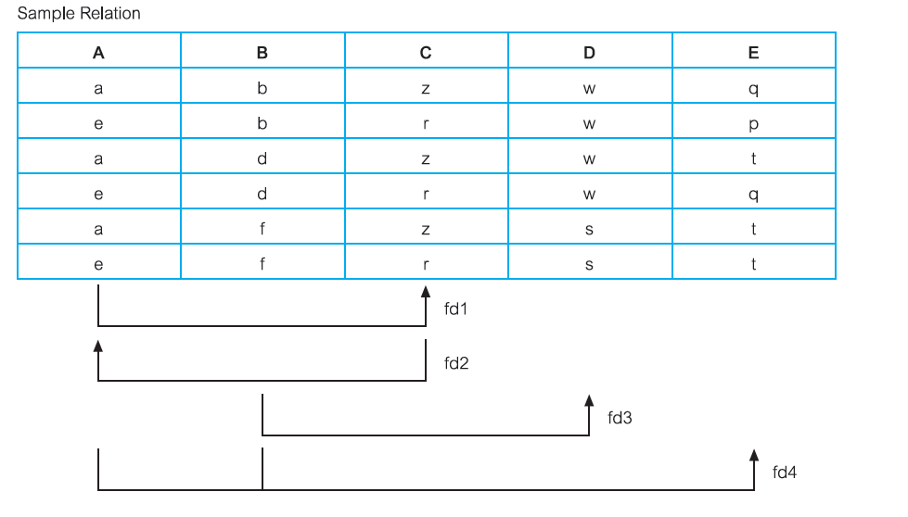
Identifying the Keys Using Closure
A → C (fd1)
C → A (fd2)
B → D (fd3)
A, B → E (fd4)

Slide 50
Identifying the Keys Using Closure
A⁺ = { A }
= { A , C } ( Using A → C )
C⁺ = { C }
= { A , C} ( Using C → A )
B⁺ = { B }
= { B , D} ( Using B → D )
AB⁺ = { A, B }
= { A, B , E } ( Using AB → E )
= { A, B , C , E } ( Using A → C )
= { A , B , C , D , E } ( Using B → D )
Thus,
AB⁺ = { A , B , C , D , E}
  The closure of attribute set AB is the entire relation schema. Thus, attribute set AB is a super key for that relation.
  No subset of attribute set AB contains all the attributes of the relation. Thus, attribute set AB is also a candidate key for that relation.
  As AB is a single candidate key of relation R, it becomes primary key.

Slide 51
Identifying the primary key for the Sample relation
The determinants in the Sample relation are A, B, C, and (A, B). However, the only determinant that functionally determines all the other attributes of the relation is (A,B).
A functionally determines C, B functionally determines D, and (A, B) functionally determines E.
In other words, the attributes that make up the determinant (A, B) can determine all the other attributes in the relation either separately as A or B or together as (A, B).
An essential characteristic for a candidate key of a relation is that the attributes of a determinant either individually or working together must be able to functionally determine all the other attributes in the relation.
As there are no other candidate keys for the Sample relation (A, B) is identified as the primary key for this relation.

Slide 52
Identifying the primary key for the StaffBranch relation
Five functional dependencies for the StaffBranch relation are:
    staffNo →sName, position, salary, branchNo, bAddress
    branchNo →bAddress
    bAddress →branchNo
    branchNo, position →salary
    bAddress, position →salary
With staffNo, branchNo, bAddress, (branchNo, position), and (bAddress, position) as determinants.
staffNo attribute uniquely identifies each tuple in this relation.
All attributes that are not part of the primary key (non-primary-key attributes) should be functionally dependent on the key.
The only candidate key of the StaffBranch relation, and therefore the primary key, is staffNo, as all other attributes of the relation are functionally dependent on staffNo.

Slide 53
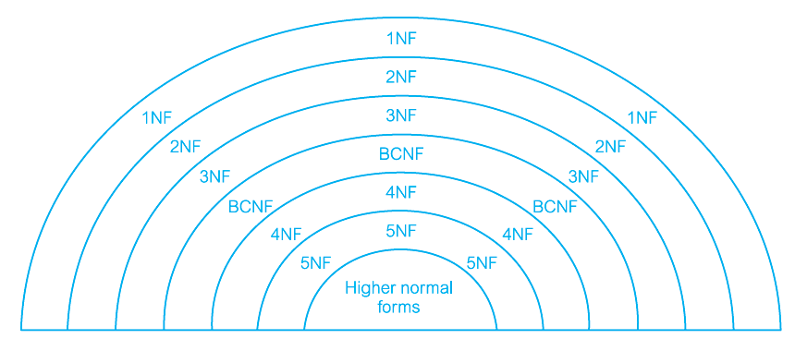
The Process of Normalization
Normalization is a formal technique for analyzing relations based on their primary key (or candidate keys) and functional dependencies.
Illustration of the relationship between the normal forms:

Slide 54
The Process of Normalization
Three normal forms were initially proposed called First Normal Form (1NF), Second Normal Form (2NF), and Third Normal Form (3NF).
Subsequently, R. Boyce and E.F. Codd introduced a stronger definition of third normal form called Boyce–Codd Normal Form (BCNF) (Codd, 1974).
With the exception of 1NF, all these normal forms are based on functional dependencies among the attributes of a relation..
Higher normal forms that go beyond BCNF were introduced later such as Fourth Normal Form (4NF) and Fifth Normal Form (5NF) (Fagin, 1977, 1979).
However, these later normal forms deal with situations that are very rare.

Slide 55
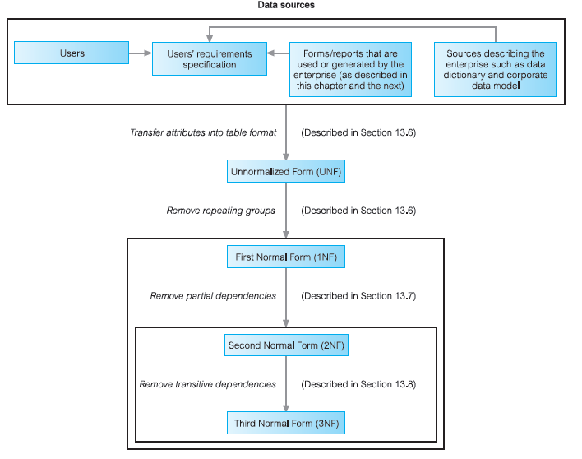
The Process of Normalization

Slide 56
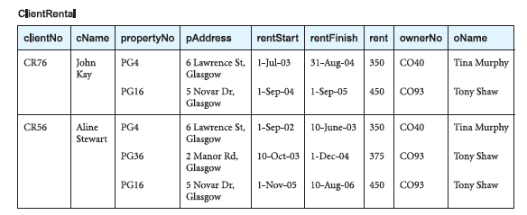
First Normal Form (1NF)
Unnormalized Form (UNF): A table that contains one or more repeating groups.
A repeating group is an attribute, or group of attributes, within a table that occurs with multiple values for a single occurrence of the nominated key attribute(s) for that table.
ClientRental unnormalized table with clientNo as a key attribute.
The structure of the repeating group is:
Repeating Group = (propertyNo, pAddress, rentStart, rentFinish, rent, ownerNo, oName)

Slide 57
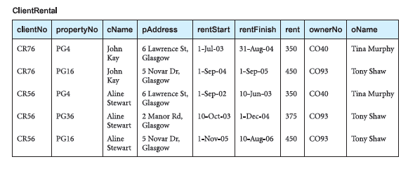
First Normal Form (1NF)
To transform the unnormalized table to First Normal Form we identify and remove repeating groups within the table.
There are two common approaches to removing repeating groups from unnormalized tables:
(1) By entering appropriate data in the empty columns of rows containing the repeating data. Commonly referred to as ‘flattening’ the table.
The resulting first normal form ClientRental relation is shown in Figure:

Slide 58
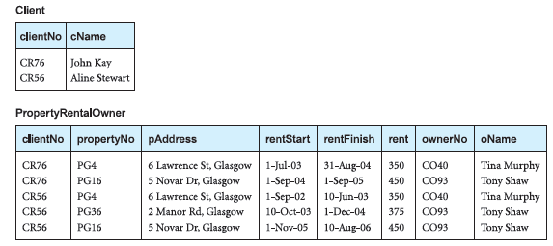
First Normal Form (1NF): Example
(2) With the second approach, we remove the repeating group by placing the repeating data along with a copy of the original key attribute (clientNo) in a separate relation
The format of the resulting 1NF relations are as follows:
Client (clientNo, cName)
PropertyRentalOwner (clientNo, propertyNo, pAddress, rentStart, rentFinish, rent, ownerNo, oName)

Slide 59
First Normal Form (1NF)
(1) By entering appropriate data in the empty columns of rows containing the repeating data. Commonly referred to as ‘flattening’ the table.
(2) By placing the repeating data, along with a copy of the original key attribute(s), in a separate relation.
1NF: A relation in which the intersection of each row and column contains one and only one value (atomic value).
  A relation will be 1NF if it contains an atomic value.
  It states that an attribute of a table cannot hold multiple values. It must hold only single-valued attribute.
  First normal form disallows the multi-valued attribute, composite attribute, and their combinations.

Slide 60
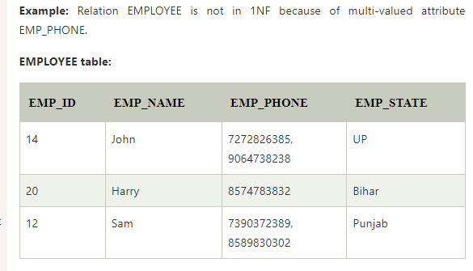

Slide 61
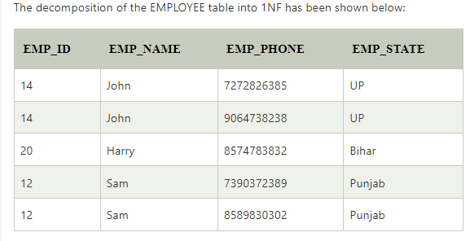

Slide 62
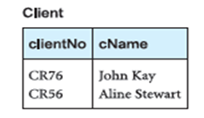
Second Normal Form (2NF)
2NF: In the 2NF, relational must be in 1NF.
A relation that is in First Normal Form and every non-primary-key attribute is fully functionally dependent on the primary key.
Second Normal Form (2NF) is based on the concept of full functional dependency.
A relation with a single-attribute primary key is automatically in at least 2NF.
Second Normal Form applies to relations with a primary key composed of two or more attributes.
A relation that is not in 2NF may suffer from the update anomalies.
  Fd1: clientNo → cName (Primary key)

Slide 63
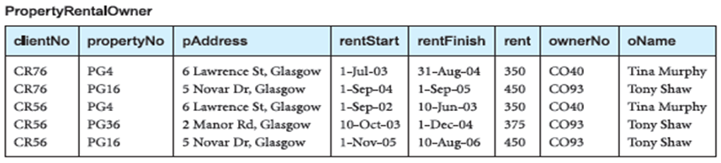
Second Normal Form (2NF)
The PropertyRentalOwner relation has the following functional dependencies:
  Fd1: clientNo, propertyNo → rentStart, rentFinish (Primary key)
  Fd2: propertyNo → pAddress, rent, ownerNo, oName (Partial dependency)
  Fd3: ownerNo → oName (Transitive dependency)
  Fd4: clientNo, rentStart → propertyNo, pAddress,
  rentFinish, rent, ownerNo, oName (Candidate key)
  Fd5: propertyNo, rentStart → clientNo, rentFinish (Candidate key)

Slide 64
Second Normal Form (2NF): Example
In fd1, the property rented attributes (rentStart and rentFinish) are fully dependent on the whole primary key; that is the clientNo and propertyNo attributes.
In fd2, the property attributes (pAddress, rent, ownerNo, oName) are partially dependent on the primary key, that is, on only the propertyNo attribute.
The identification of partial dependencies within the PropertyRentalOwner relation indicates that the relation is not in 2NF.
To transform the PropertyRentalOwner relation into 2NF requires the creation of new relations so that every nonprimary- key attribute is fully functionally dependent on the primary key of the relation.

Slide 65
Second Normal Form (2NF): Example
The normalization of 1NF relations to 2NF involves the removal of partial dependencies.
If a partial dependency exists, we remove the partially dependent attribute(s) from the relation by placing them in a new relation along with a copy of their determinant.
PropertyRentalOwner (clientNo, propertyNo, pAddress, rentStart, rentFinish, rent, ownerNo, oName)
Decompose into:
  Rental (clientNo, propertyNo, rentStart, rentFinish)
  PropertyOwner (propertyNo, pAddress, rent, ownerNo, oName)

Slide 66
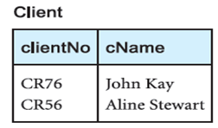
Second Normal Form (2NF): Example
This results in the creation of two new relations called Rental, and PropertyOwner.
  Rental (clientNo, propertyNo, rentStart, rentFinish)
  PropertyOwner (propertyNo, pAddress, rent, ownerNo, oName)
  fd1: clientNo → cName (Primary key)

Slide 67
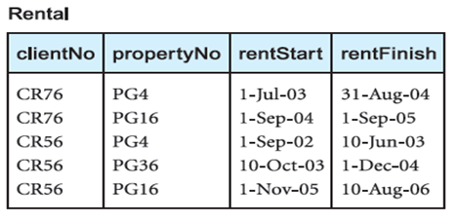
Second Normal Form (2NF): Example
    Fd1: clientNo, propertyNo → rentStart, rentFinish (Primary key)
    Fd2: clientNo, rentStart → propertyNo, rentFinish (Candidate key)
    Fd3: propertyNo, rentStart → clientNo, rentFinish (Candidate key)

Slide 68
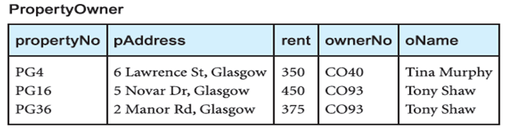
Second Normal Form (2NF): Example
    Fd3: propertyNo → pAddress, rent, ownerNo, oName (Primary key)
    Fd4: ownerNo → oName (Transitive dependency)

Slide 69
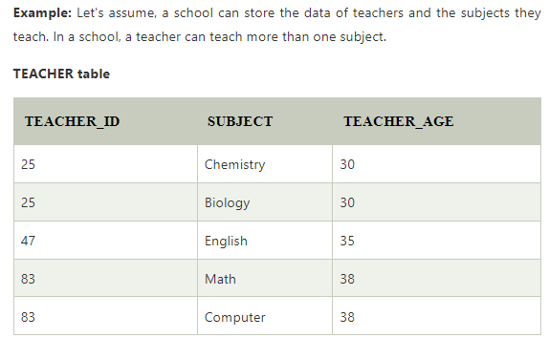
Example 2 : 2NF

Slide 70


2NF form

Slide 71
Third Normal Form (3NF)
Although 2NF relations have less redundancy than those in 1NF, they may still suffer from update anomalies.
3NF: A relation that is in First and Second Normal Form and in which no non-primary-key attribute is transitively dependent on the primary key.
The normalization of 2NF relations to 3NF involves the removal of transitive dependencies.
If a transitive dependency exists, we remove the transitively dependent attribute(s) from the relation by placing the attribute(s) in a new relation along with a copy of the determinant.
3NF is used to reduce the data duplication. It is also used to achieve the data integrity

Slide 72
3NF
A relation is in third normal form if it holds at least one of the following conditions for every non-trivial function dependency X → Y.
  X is a super key.
  Y is a prime attribute, i.e., each element of Y is part of some candidate key.

Slide 73

Example:3NF

Slide 74
Transitive dependency in relation
Super key in the table above:
{EMP_ID}, {EMP_ID, EMP_NAME}, {EMP_ID, EMP_NAME, EMP_ZIP}....so on
Candidate key: {EMP_ID}
Non-prime attributes: In the given table, all attributes except EMP_ID are non-prime.
Here, EMP_STATE & EMP_CITY dependent on EMP_ZIP and EMP_ZIP dependent on EMP_ID. The non-prime attributes (EMP_STATE, EMP_CITY) transitively dependent on super key(EMP_ID). It violates the rule of third normal form.
That's why we need to move the EMP_CITY and EMP_STATE to the new <EMPLOYEE_ZIP> table, with EMP_ZIP as a Primary key.

Slide 75
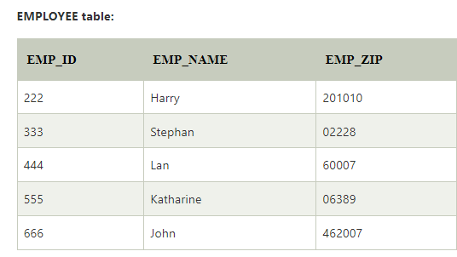

3NF form

Slide 76
Third Normal Form (3NF): Example
All the non-primary-key attributes within the Client and Rental relations are functionally dependent on only their primary keys. The Client and Rental relations have no transitive dependencies and are therefore already in 3NF.
All the non-primary-key attributes within the PropertyOwner relation are functionally dependent on the primary key, with the exception of oName, which is transitively dependent on ownerNo (represented as fd4).
To transform the PropertyOwner relation into 3NF we must first remove this transitive dependency by creating two new relations called PropertyForRent and Owner:
  PropertyForRent (propertyNo, pAddress, rent, ownerNo)
  Owner (ownerNo, oName)

Slide 77
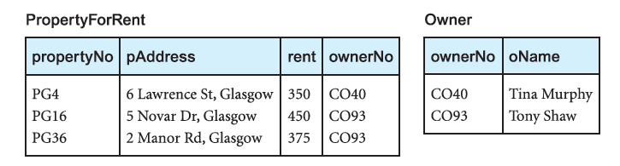
Third Normal Form (3NF): Example

Slide 78
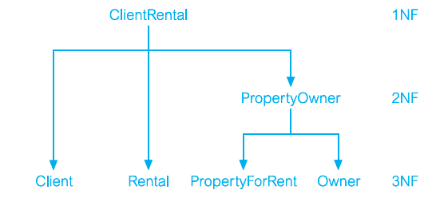
Normalization
The ClientRental relation has been transformed by the process of normalization into four relations in 3NF.
The resulting 3NF relations have the form:
  Client (clientNo, cName)
  Rental (clientNo, propertyNo, rentStart, rentFinish)
  PropertyForRent (propertyNo, pAddress, rent, ownerNo)
  Owner (ownerNo, oName)

Slide 79
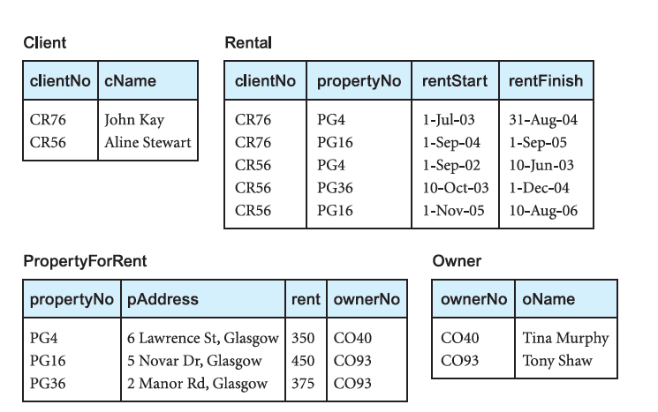
Normalization
A summary of the 3NF relations derived from the ClientRental relation.

Slide 80
Minimal Sets of Functional Dependencies
A set of functional dependencies Y is covered by a set of functional dependencies X, if every functional dependency in Y is also in X⁺; that is, every dependency in Y can be inferred from X.
A set of functional dependencies X is minimal if it satisﬁes the following conditions:
  Every dependency in X has a single attribute on its right-hand side.
  We cannot replace any dependency A → B in X with dependency C → B, where C is a proper subset of A, and still have a set of dependencies that is equivalent to X.
  We cannot remove any dependency from X and still have a set of dependencies that is equivalent to X.
A minimal set of dependencies should be in a standard form with no redundancies.
A minimal cover of a set of functional dependencies X is a minimal set of dependencies X_{min} that is equivalent to X.

Slide 81
Minimal Sets of Functional Dependencies: Example
The functional dependencies based on our understanding of the attributes in the relation as:
    staffNo →sName, position, salary, branchNo, bAddress
    branchNo →bAddress
    bAddress →branchNo
    branchNo, position →salary
    bAddress, position →salary

Slide 82
Minimal Sets of Functional Dependencies: Example
We apply these three conditions on the set of functional dependencies for the StaffBranch to produce the following functional dependencies:
  staffNo → sName
  staffNo → position
  staffNo → salary
  staffNo → branchNo
  staffNo → bAddress
  branchNo → bAddress
  bAddress → branchNo
  branchNo, position → salary
  bAddress, position → salary

Slide 83
Boyce–Codd Normal Form (BCNF)
2NF and 3NF disallow partial and transitive dependencies on the primary key of a relation, respectively.
Relations that have these types of dependencies may suffer from the update anomalies.
However, the definition of 2NF and 3NF do not consider whether such dependencies remain on other candidate keys of a relation.
This weakness in 3NF, resulted in the presentation of a stronger normal form called Boyce–Codd Normal Form.
Boyce–Codd Normal Form (BCNF) is based on functional dependencies that take into account all candidate keys in a relation.
A relation is in BCNF, if and only if, every determinant is a candidate key.

Slide 84
Boyce–Codd Normal Form (BCNF)
A determinant is an attribute, or a group of attributes, on which some other attribute is fully functionally dependent.
To test whether a relation is in BCNF, we identify all the determinants and make sure that they are candidate keys.
Boyce–Codd Normal Form is a stronger form of 3NF, such that every relation in BCNF is also in 3NF. However, a relation in 3NF is not necessarily in BCNF.
The functional dependencies for the Client, Rental, and PropertyOwner relations are as follows:
  fd1: clientNo → cName (Primary key)

Slide 85
BCNF
BCNF is the advance version of 3NF. It is stricter than 3NF.
A table is in BCNF if every functional dependency X → Y, X is the super key of the table.
For BCNF, the table should be in 3NF, and for every FD, LHS is super key.

Slide 86
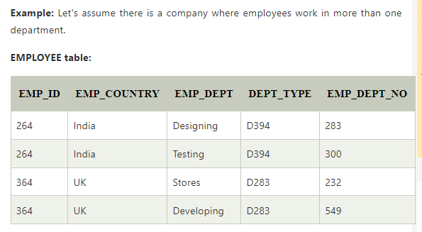
EXAMPLE
In the above table Functional dependencies are as follows:
EMP_ID → EMP_COUNTRY
EMP_DEPT → {DEPT_TYPE, EMP_DEPT_NO}
Candidate key: {EMP-ID, EMP-DEPT}

Slide 87
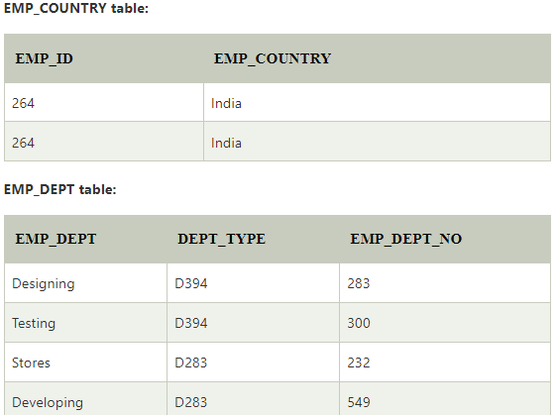
BCNF conversion
The table is not in BCNF because neither EMP_DEPT nor EMP_ID alone are keys.
To convert the given table into BCNF, we decompose it into three tables:

Slide 88
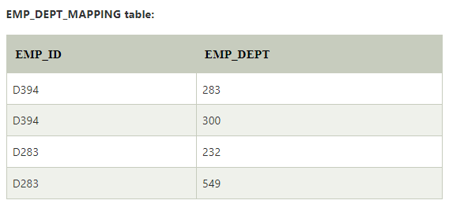
Functional dependencies:
EMP_ID → EMP_COUNTRY
EMP_DEPT → {DEPT_TYPE, EMP_DEPT_NO}
Candidate keys:
For the first table: EMP_ID
For the second table: EMP_DEPT
For the third table: {EMP_ID, EMP_DEPT}

Slide 89
Boyce–Codd Normal Form (BCNF)
    Fd1: clientNo, propertyNo → rentStart, rentFinish (Primary key)
    Fd2: clientNo, rentStart → propertyNo, rentFinish (Candidate key)
    Fd3: propertyNo, rentStart → clientNo, rentFinish (Candidate key)

Slide 90
Boyce–Codd Normal Form (BCNF):Example
PropertyForRent:
    Fd3: propertyNo → pAddress, rent, ownerNo, oName (Primary key)
Owner:
    Fd4: ownerNo → oName (Primary key)
The Client, PropertyForRent, and Owner relations are all in BCNF, as each relation only has a single determinant.
As the three determinants of the Rental relation are also candidate keys, the Rental relation is also already in BCNF.

Slide 91
Fourth Normal Form (4NF): Multi-Valued Dependency
For a table to satisfy the Fourth Normal Form, it should satisfy the following two conditions:
  It should be in the Boyce-Codd Normal Form.
  And, the table should not have any Multi-valued Dependency.
A table is said to have multi-valued dependency, if the following conditions are true,
  For a dependency A → B, if for a single value of A, multiple value of B exists, then the table may have multi-valued dependency.
  Also, a table should have at-least 3 columns for it to have a multi-valued dependency.
  And, for a relation R(A,B,C), if there is a multi-valued dependency between, A and B, and A and C, then B and C should be independent of each other.
  A ⎯>> B
  A ⎯>> C
If all these conditions are true for any relation(table), it is said to have multi-valued dependency.

Slide 92

Fourth Normal Form (4NF): Multi-Valued Dependency
The given STUDENT table is in 3NF: In the STUDENT relation, a student with STU_ID, 21 contains two courses, Computer and Math and two hobbies, Dancing and Singing. So there is a Multi-valued dependency on STU_ID, which leads to unnecessary repetition of data.
The COURSE and HOBBY are two independent entity. Hence, there is no relationship between COURSE and HOBBY.

Slide 93

Fourth Normal Form (4NF): Multi-Valued Dependency
So to make the above table into 4NF, we can decompose it into two tables:

Slide 94
Fifth Normal Form (5NF): Lossless-Join Dependency
Joint dependency – Join decomposition is a further generalization of Multivalued dependencies.
If the join of R1 and R2 over C is equal to relation R then we can say that a join dependency (JD) exists, where R1 and R2 are the decomposition R1(A, B, C) and R2(C, D) of a given relations R (A, B, C, D).
Alternatively, R1 and R2 are a lossless decomposition of R.
Let R is a relation schema R1, R2, R3……..Rn be the decomposition of R. r( R ) is said to satisfy join dependency if and only if

Slide 95
Fifth Normal Form (5NF): Lossless-Join Dependency
A relation R is in 5NF if and only if every join dependency in R is implied by the candidate keys of R.
A relation decomposed into two relations must have loss-less join property, which ensures that no spurious or extra tuples are generated, when relations are reunited through a natural join.
A relation R is in 5NF if and only if it satisfies following conditions:
  R should be already in 4NF.
  not contains any join dependency and joining should be lossless.
  5NF is satisfied when all the tables are broken into as many tables as possible in order to avoid redundancy.
Fifth Normal Form (5NF) also called Project-Join Normal Form (PJNF).

Slide 96
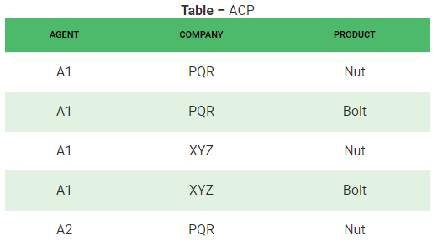
Fifth Normal Form (5NF)
Consider example : “if a company makes a product and an agent is an agent for that company, then he always sells that product for the company”. The ACP table is shown as:

Slide 97

Fifth Normal Form (5NF)
The relation ACP is again decompose into 3 relations.

Slide 98
Fifth Normal Form (5NF)
Result of Natural Join of R1 and R3 over ‘Company’ and then Natural Join of R3 and R2 over ‘Agent’and ‘Product’ will be table ACP.
Hence, in this example, all the redundancies are eliminated, and the decomposition of ACP is a lossless join decomposition. Therefore, the relation is in 5NF as it does not violate the property of lossless join.

Slide 99

Example2: 5NF

Slide 100

Decomposition : 5NF

Slide 101

Decomposition : 5NF

Slide 102
Lossless Join and Dependency Preserving Decomposition
Decomposition of a relation is done when a relation in relational model is not in appropriate normal form.
There are two important properties associated with decomposition of a larger relation into smaller relations:
The lossless-join property ensures that any instance of the original relation can be identified from corresponding instances in the smaller relations.
The dependency preservation property ensures that a constraint on the original relation can be maintained by simply enforcing some constraint on each of the smaller relations.

Slide 103
Lossless Join Decomposition
If we decompose a relation R into relations R1 and R2,
  Decomposition is lossy if R1 ⋈ R2 ⊃ R
  Decomposition is lossless if R1 ⋈ R2 = R
To check for lossless join decomposition using FD set, following conditions must hold:
  Union of Attributes of R1 and R2 must be equal to attribute of R. Each attribute of R must be either in R1 or in R2.
  Att(R1) U Att(R2) = Att(R)
  Intersection of Attributes of R1 and R2 must not be NULL.
  Att(R1) ∩ Att(R2) ≠ Φ
  Common attribute must be a key for at least one relation (R1 or R2)
  Att(R1) ∩ Att(R2) → Att(R1) or
  Att(R1) ∩ Att(R2) → Att(R2)

Slide 104
Lossless Join Decomposition
For Example, A relation R (A, B, C, D) with FD set{A → BC} is decomposed into R1(ABC) and R2(AD) which is a lossless join decomposition as:
  First condition holds true as Att(R1) U Att(R2) = (ABC) U (AD) = (ABCD) = Att(R).
  Second condition holds true as Att(R1) ∩ Att(R2) = (ABC) ∩ (AD) ≠ Φ
  Third condition holds true as Att(R1) ∩ Att(R2) = A is a key of R1(ABC) because A → BC is given.

Slide 105
Dependency Preserving Decomposition
If we decompose a relation R into relations R1 and R2, all dependencies of R either must be a part of R1 or R2 or must be derivable from combination of FD’s of R1 and R2.
For Example, A relation R (A, B, C, D) with FD set {A->BC} is decomposed into R1(ABC) and R2(AD) which is dependency preserving because FD A->BC is a part of R1(ABC).

Slide 106
Lossless Join and Dependency Preserving Decomposition
Consider a schema R(A,B,C,D) and functional dependencies A → B and C → D. Then the decomposition of R into R1(AB) and R2(CD) is
A. dependency preserving and lossless join
B. lossless join but not dependency preserving
C. dependency preserving but not lossless join
D. not dependency preserving and not lossless join
For lossless join decomposition, three conditions must hold true:
  Att(R1) U Att(R2) = ABCD = Att(R)
  Att(R1) ∩ Att(R2) = Φ, which violates the condition of lossless join decomposition.
  Hence the decomposition is not lossless.
For dependency preserving decomposition,
  A → B can be ensured in R1(AB) and
  C → D can be ensured in R2(CD).
  Hence it is dependency preserving decomposition.
  So, the correct option is C.

Slide 107
Lossless Join and Dependency Preserving Decomposition
Let a relation R(A,B,C,D) and set a FDs F = { A → B , A → C , C → D} are given. A relation R is decomposed into - R₁ = (A, B, C) with FDs F₁ = {A → B, A → C}, and R₂ = (C, D) with FDs F₂ = {C → D}
For lossless join decomposition, three conditions must hold true:
  Att(R1) U Att(R2) = ABCD = Att(R)
  Att(R1) ∩ Att(R2) = C,
  C is primary key of R2 {C → D}
  Hence the decomposition is lossless join
For dependency preserving decomposition,
  A → B and A → C can be ensured in R1(ABC) and
  C → D can be ensured in R2(CD).
  Hence it is dependency preserving decomposition.

Slide 108
End of Unit 2

